Slide 1

Sprint Review and Retrospective
By Alex Espinoza

Slide 2
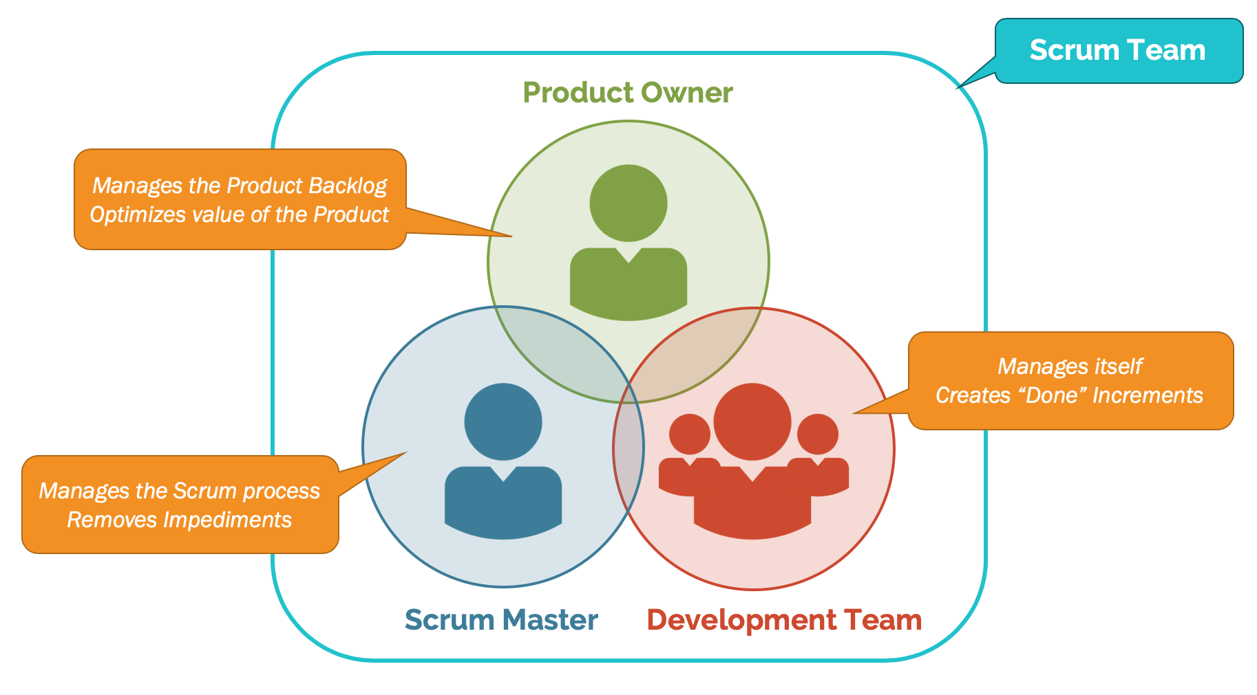
Scrum Roles
Scrum relies on relationships between the roles. The major roles are:
-Product Owner
-Development Team
-Scrum Master

Slide 3
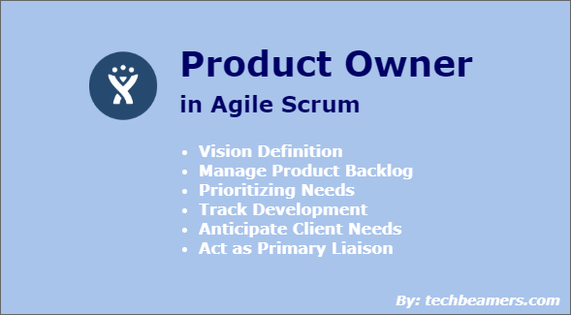
Product Owner

Slide 4
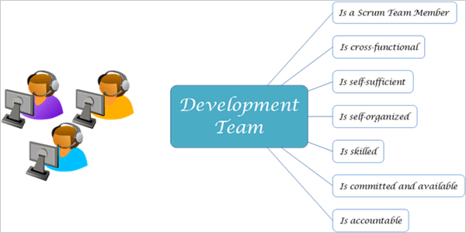
Developer/Tester

Slide 5
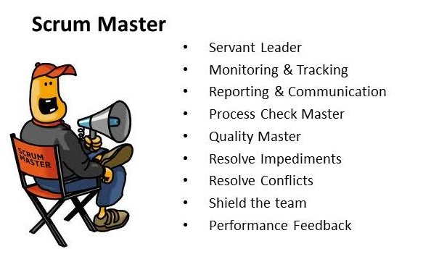
SCRUM Master

Slide 6
Phases of SDLC and How They Work In Agile
There are typically 6 stages in agile called SDLC or Software Development Life Cycles
1: Requirements
2: Design
3: Development and Coding
4: Integration and Testing
5: Implementation and Deployment
6: Review

Slide 7
How Do The Phases of SDLC Connect With Agile-SCRUM
1. Requirements: You ask the product owner and investor what they want as well as the users
2. Design: You ask the users what looks best and the developers and also investor if they like the direction
3. Development and Coding: You use the developers and testers to create the project and use the scrum master to keep check on the progress and have them complete the user stories.
4. Integration and Testing: You allow the testers to do their job and see what needs to be changed before the developers integrate the code into the final project.
5. Implementation and Deployment: Have the developers implement have the product owner make sure it is fine and have the scrum master see the unfinished user stories and prioritize what is left.
6. Review: Have each role take a look at what has been created and see what is working and what isn’t user reviews are important at this step and can be used for future updates.

Slide 8
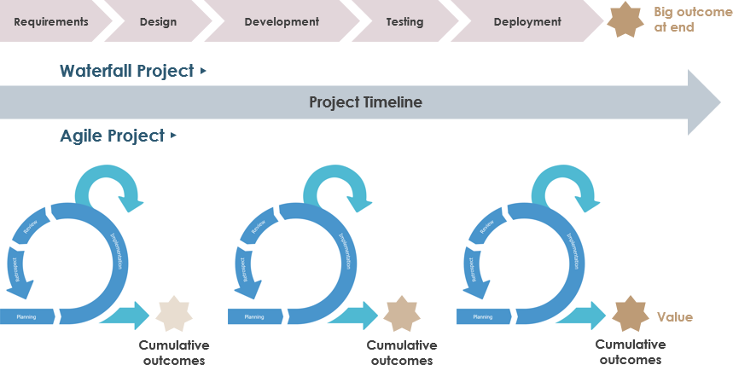
Waterfall vs Agile-SCRUM

Slide 9
Biggest Differences between Agile-SCRUM and Waterfall
Waterfall is rigid and has predetermined steps and requirements with a set time frame.
Agile is flexible and best when used to create never done before projects or programs.
Waterfall is great for things that have been done many times before and need to be done again. Just follow the recipe.
Agile is great for doing new things that require flexibility and change. When roadblocks are hit agile adapts, waterfall doesn’t as well.
Agile is a loop, Waterfall is a line.

Slide 10
When to choose Waterfall or Agile-Scrum
Waterfall when the thing you are creating has been made many times before and has basically a recipe for how to recreate it.
Agile for things that have never been done before and are expected to overcome roadblocks. Things like programs are a great use of Agile-Scrum.
Use Waterfall when you have a limited amount of money and don’t want to go over.
Use Agile when you want your product to meet certain requirements and want to create something new.

Slide 11
Sources
Intro slide image: https://i.ytimg.com/vi/lcL678AASFc/maxresdefault.jpg
Slide 2 Image: https://scrumorg-website-prod.s3.amazonaws.com/drupal/inline-images/2019-01/scrum%20team.png
Slide 3 Image: https://www.techbeamers.com/wp-content/uploads/2019/06/Product-Owner-Role-in-Agile-Scrum.png
Slide 4 Image: https://www.softwaretestinghelp.com/wp-content/qa/uploads/2018/07/dev-team.png
Slide 5 Image: http://4.bp.blogspot.com/-70-N-3q473A/Ua7NuQippWI/AAAAAAAAEKI/F-iEspfHbIo/s1600/Scrum+Master+R&R.jpg
Slide 8 Image: https://www.visual-paradigm.com/servlet/editor-content/scrum/scrum-vs-waterfall-vs-agile-vs-lean-vs-kanban/sites/7/2018/12/agile-vs-waterfall.png

